Slide 1
Furry Friends Animal Shelter: Records System
Anuj Bhyravabhotla
Northview High School
Georgia
Notes:
Good morning/afternoon/evening judges. I’m Anuj Bhyravabhotla from Northview High School in Georgia and I present to you my records system for the Furry Friends Animal Shelter

Slide 2
Principal Problem
S
E
E
Notes:
The problem was this: Furry Friends Animal Shelter has asked you to develop an animal records system. Create an interface that allows supervisors and staff to enter animal patient information and print information-based reports. In doing so, the principle problem was three-fold. These were the three goals I was trying to achieve for my application.

Slide 3
Principal Problem
Simple
E
E
Notes:
Simple: I tried to make my interface as intuitive and as easy to follow as I could. This was the hardest goal to achieve due to the complex nature of the window layouts I had at my disposal

Slide 4
Principal Problem
Simple
Effective
E
Notes:
Effective: This was the most obvious goal; making a program that got the job done with few runtime errors.

Slide 5
Principal Problem
Simple
Effective
Efficient
Notes:
Efficient: I tried to have the program complete the job using as few resources as possible.

Slide 6
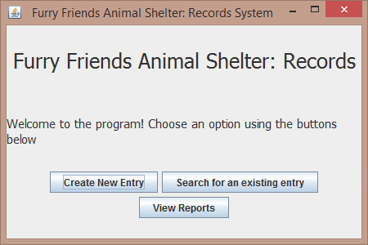
Principal Problem
Simple
Effective
Efficient
Notes:
So consider this screen. I feel it is simple because it includes instructions for the program flow and buttons for the user to easily select any of the options presented. It is effective because when either button is pressed, the appropriate screen appears allowing the user to carry out the option selected. It is efficient because between screens, there was usually little to no downtime.

Slide 7
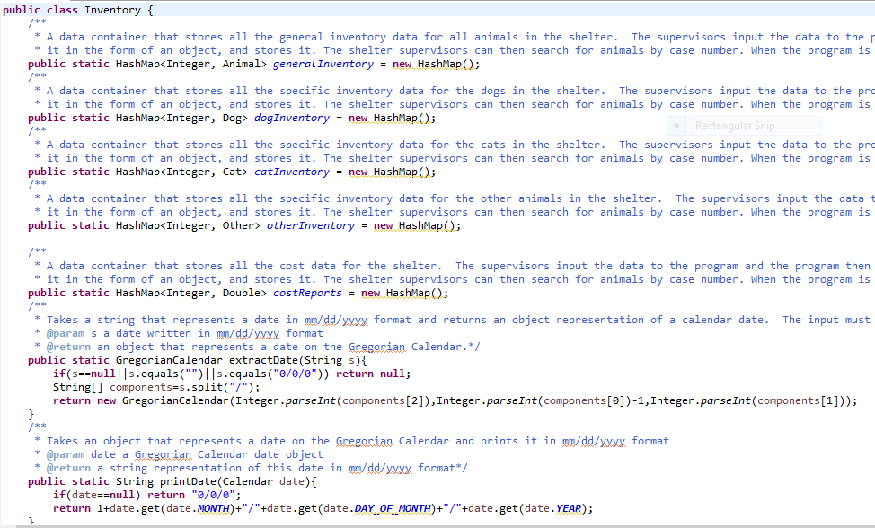
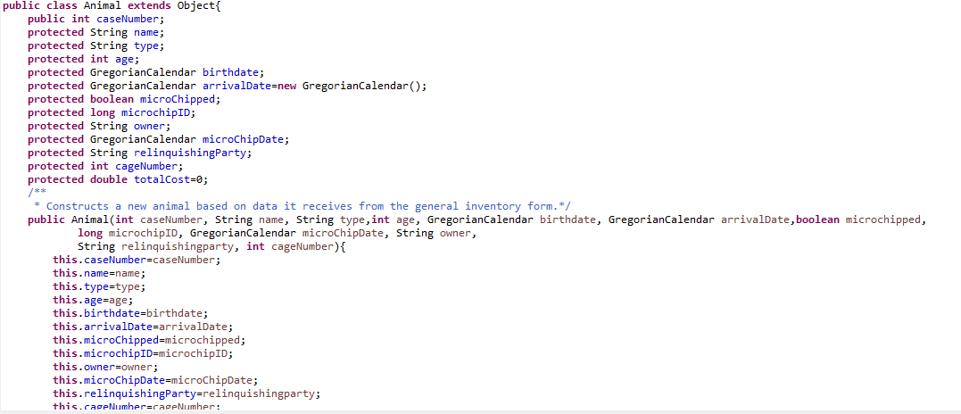
Challenges
Database Design (Storage/Recall)
Reporting
Object Design
Final Verdict: Simplicity Trumps All
Notes:
Someone once said, “People always see it the way it appears, but they never see the ropes and the pulleys and the gears.” These are the ropes and the pulleys and the gears. My principal challenges had to do with my data and how I was going to store, recall, present, and manipulate it. My guiding principal in solving these was:

Slide 8
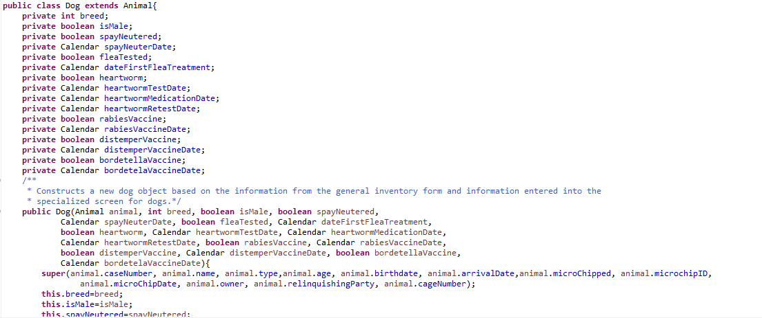
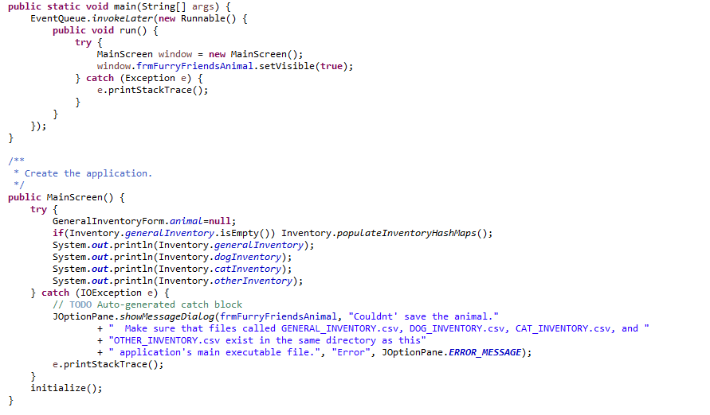
Planning
Step 1: Data Storage
Step 2: Algorithms
Step 3: Interface Design
Step 4: Reporting

Slide 9
It all starts with choice

Slide 10
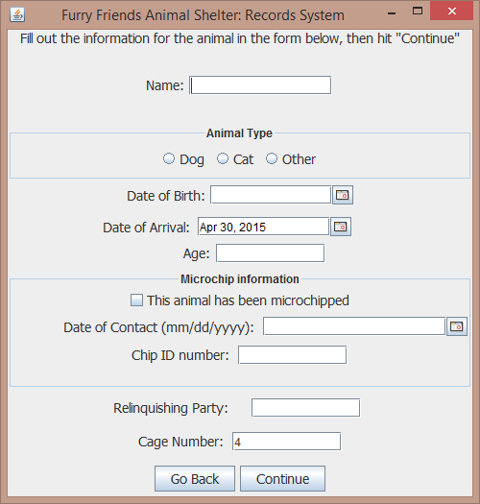
The General Inventory Form
Chip ID and Cage number fields can only contain numbers to avoid errors

Slide 11
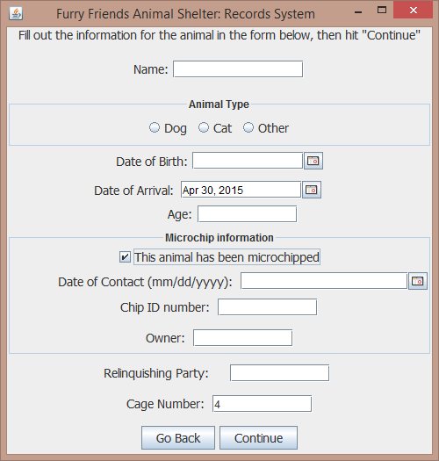
The General Inventory Form
Chip ID and Cage number fields can only contain numbers to avoid errors

Slide 12
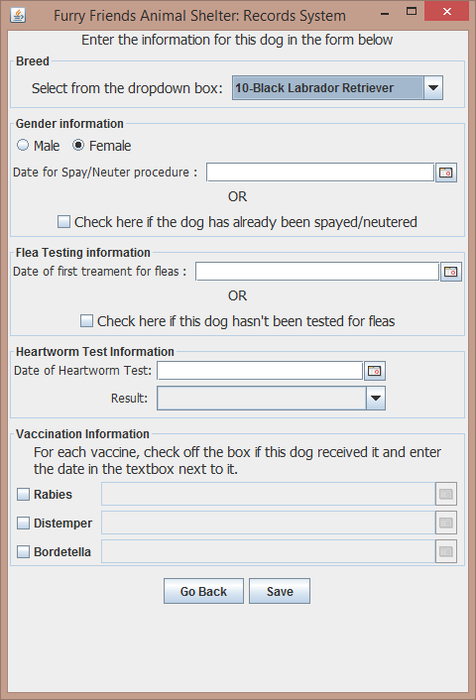
The Special Inventory Form for dogs

Slide 13
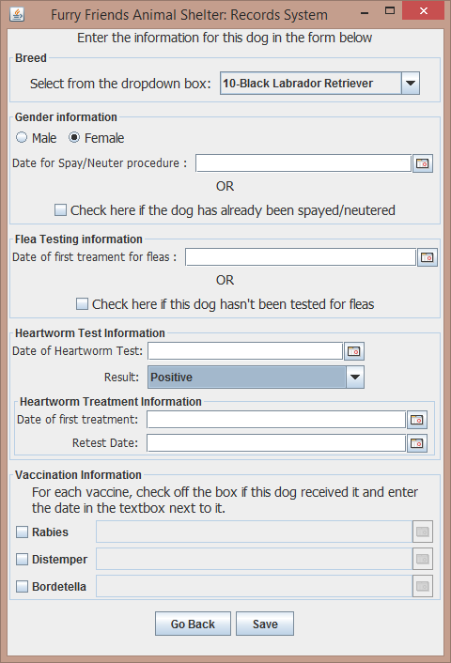
The Special Inventory Form for dogs

Slide 14
Back to the Start

Slide 15
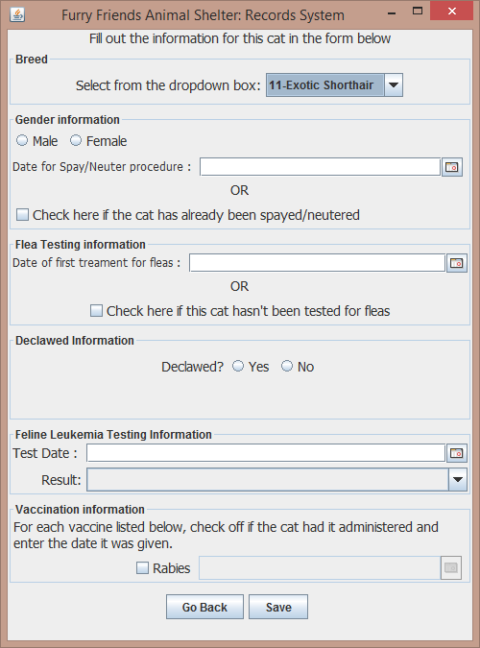
The Special Inventory Form for cats

Slide 16
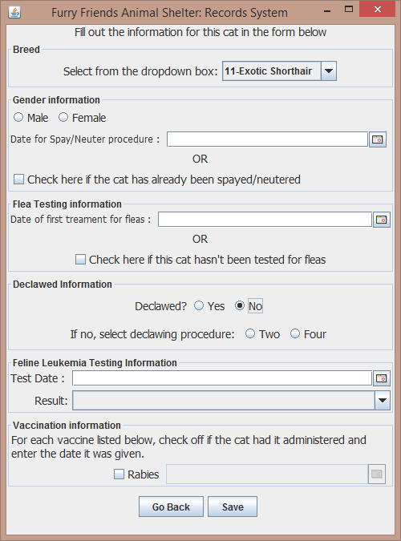
The Special Inventory Form for cats

Slide 17
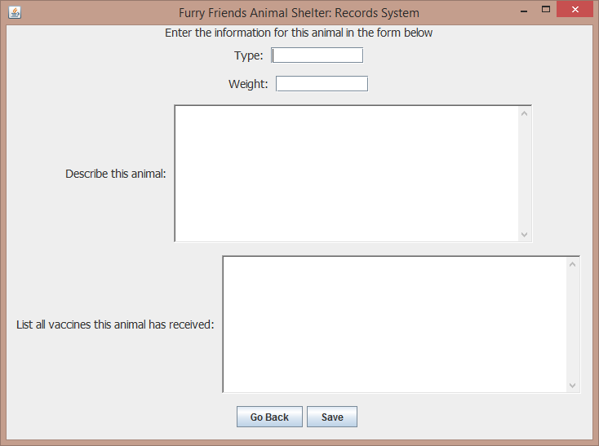
The Special Inventory Form for neither dogs nor cats
Weight field can only contain numbers to avoid errors

Slide 18
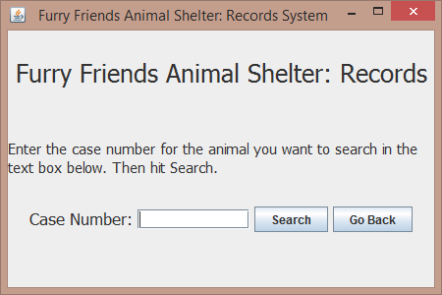
Searching
Case number field must contain numbers to avoid errors

Slide 19
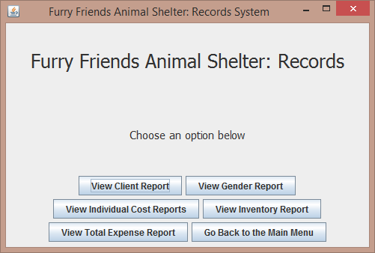
Reports
Report Menu

Slide 20
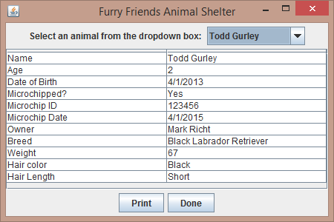
Reports
Client Reports for each Animal

Slide 21
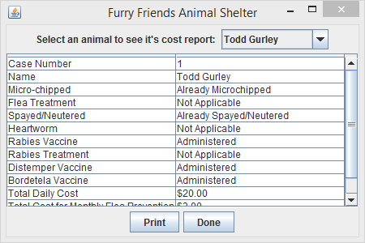
Reports
Cost Reports for each Animal

Slide 22
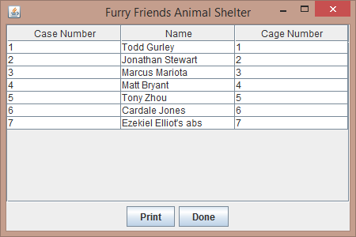
Reports
Inventory report for the entire shelter

Slide 23
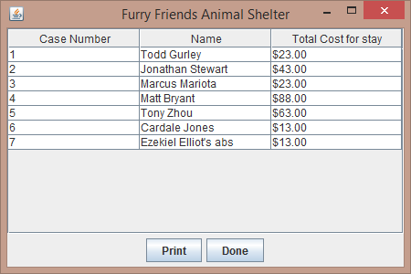
Reports
Expense report for the entire shelter

Slide 24
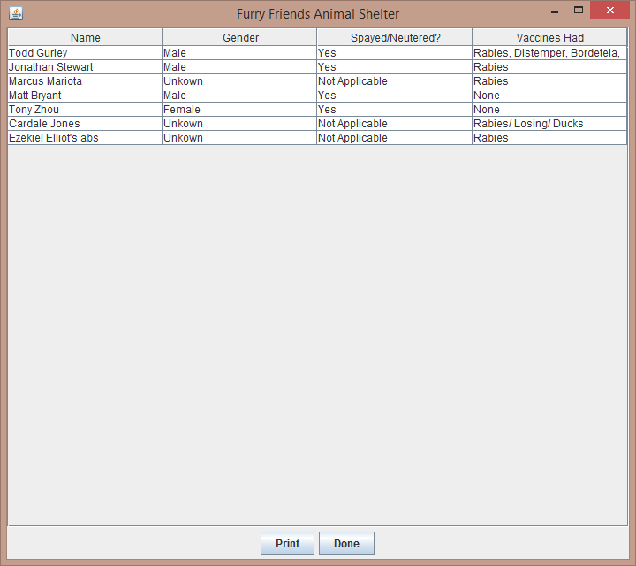
Reports
Gender Report for the entire shelter

Slide 25
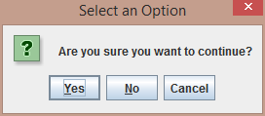
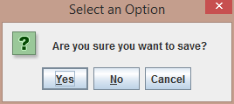
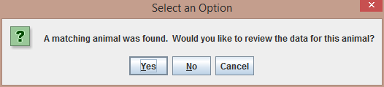
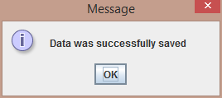
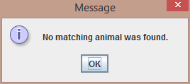
The Human Component

Slide 26
Problem Solved
Simple
Effective
Efficient

Slide 27
Furry Friends Animal Shelter: Records System
Anuj Bhyravabhotla
Northview High School
Georgia
Notes:
Good morning/afternoon/evening judges. I’m Anuj Bhyravabhotla from Northview High School in Georgia and I present to you my records system for the Furry Friends Animal Shelter

Slide 28
Palette
Palette
Palette
Palette
Palette

